Slide 1
European Comenius Project
PHENOLOGY
Rythms of life and relation with climate

Slide 2
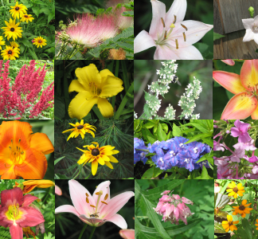
European Comenius Project
PHENOLOGY
OUR COMMON TREES
Comparative table

Slide 3
Common trees
✓ | We are sure we have.
✗ | We are sure we have not.
 | We are not sure yet. We are trying to find out.

Slide 4
Common trees
Trees | Arette | Cómpeta | Lamego | Medas | Szczecin
Acacia dealbata |  | ✓
Acacia melanoxylon |  |  |  | ✓
Acer negundo | ✓ |  |  | ✓ | ✓
Acer pseudoplatanus |  |  |  | ✓
Betula alba |  |  |  | ✓
Castanea sativa | ✓ |  |  | ✓
Ceratonia siliqua |  | ✓ |  | ✗
Eucalyptus |  | ✓ |  | ✓
Ligustrum japonicum |  |  |  | ✓
Malus |  |  | ✓ | ✓ | ✓
Olea europeaea |  | ✓
Pinus pinaster |  | ✓ |  | ✓

Slide 5
Common trees
Trees | Arette | Cómpeta | Lamego | Medas | Szczecin
Platanus x hispanica |  | ✓ |  | ✓
Populus nigra |  |  |  | ✓ | ✓
Quercus coccifera |  |  |  | ✓
Quercus faginea |  | ✓ |  | ✗
Quercus robur | ✓ |  |  | ✓ | ✓
Quercus rotundifolia |  | ✓ |  | ✗
Quercus suber |  | ✓ |  | ✓
Salix | ✓ |  |  | ✓ | ✓
Tilia |  |  | ✓ | ✓ | ✓

Slide 6
Common shrubs
Trees | Arette | Cómpeta | Lamego | Medas | Szczecin
Corylus avellana* | ✓ | * |  | ✓ | ✓
Juniperus communis |  | ✓ |  | ✗
Ilex |  |  | ✓ | ✓
Lavandula officinalis |  | ✓ |  | ✓
Pistacia lentiscus |  | ✓ |  | ✗
Rosmarinus officinalis |  | ✓ | ✓ | ✓
Thymus vulgaris |  | ✓ |  | ✓
Vitis vinifera |  | ✓ | ✓ | ✓
* We are sure we have not corylus avellana, we have the possibility of planting corylus maxima in February

Slide 7
European Comenius Project
PHENOLOGY
Rythms of life and relation with climate
Notes:
7

